Slide 1
A Mini Project Report on
BASIC ELECTRICAL ENGINEERING
Submitted in partial fulfilment of the requirement for the Degree of
B. Tech.
in
Computer Science and Technology
Submitted By:
1. Rajeev Dhaka : 1912125 4. Ashish Upadhyaya : 1912132 7. Prottay Kumar Adhikary : 1912157
2. Jatin Nigam : 1912130 5. Deepak Kumar : 1912140 8. Saurabh Sinha : 1912159
3. Nikhil Choudhary : 1912131 6. Nehal Choudhary : 1912141 9. Subhojit Ghimire : 1912160
Under the guidance of:
Dr. Sreejith. S
Assistant Professor
Department of Electrical Engineering
NIT Silchar

Slide 2
Rotating Magnetic Field
A magnetic field that has moving polarities in which its opposite poles rotate about a central point or axis.
The rotation changes direction at a constant angular rate.
Rotating magnetic fields are often utilised for electromechanical applications.
They are also used in purely electrical applications.

Slide 3
Condition for Generation of Rotating Magnetic Field
When a balanced poly phase current flows in the balanced poly phase winding, a rotating magnetic field is produced.
“The time angle displace between the currents and space angle displacement between the winding axes must be equal.” This is the necessary condition for generation of rotating magnetic field.

Slide 4
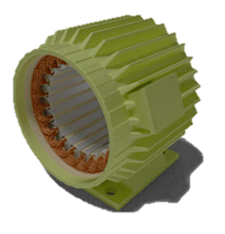
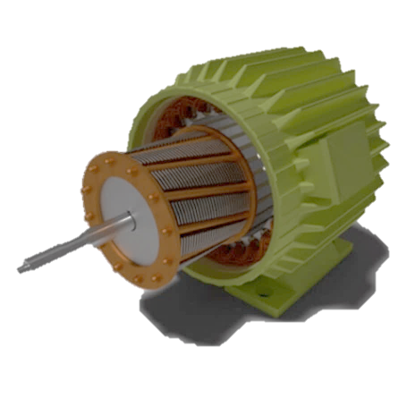
Working Principle of Rotating Magnetic Field in Three Phase Induction Motor
Three phase induction motor converts electrical energy into mechanical energy, just like any motor. It doesn’t require an additional starting device.
Three phase induction motor consists of two major parts: stator and rotor.
Stator of 3 phase induction motor
Rotor of 3 phase induction motor

Slide 5
Working of Three Phase Induction Motor- Production of Rotating Magnetic Field
The stator of the motor consists of overlapping winding offset by an electrical angle of 120⁰.
The relative speed between the rotating flux and static rotor conductor is the cause of current generation.
The rotor speed should not reach the synchronous speed produced by the stator.
The three phase induction motor is self-starting, robust in construction, economical and easier to maintain.

Slide 6
Resonance in Parallel RLC Circuit
The frequency at which parallel RLC circuit resonates is called resonance frequency.
Condition for Resonance is X_{L}=X_{C}.
Parallel resonance occurs when the supply frequency creates zero phase difference between the supply voltage and current producing a resistive circuit.

Slide 7
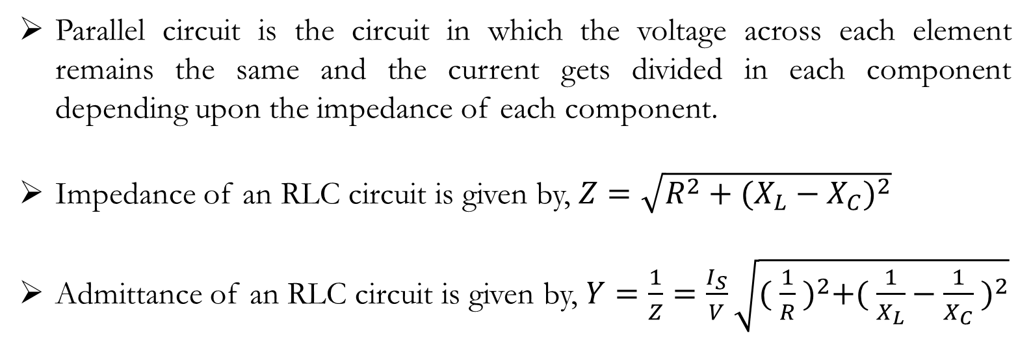
Parallel RLC Circuit
Parallel circuit is the circuit in which the voltage across each element remains the same and the current gets divided in each component depending upon the impedance of each component.
Impedance of an RLC circuit is given by, $Z=\sqrt{R^{2}+{(X_{L}−X_{C})}^{2}}$
Admittance of an RLC circuit is given by, $Y=\frac{1}{Z}=\frac{I_{S}}{V}\sqrt{{( \frac{1}{R} )}^{2}+{( \frac{1}{X_{L}}−\frac{1}{X_{C}} )}^{2}}$

Slide 8
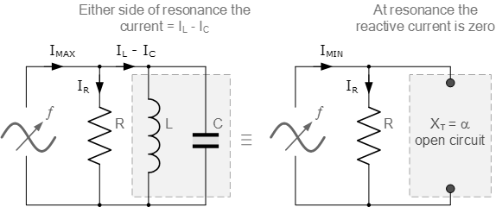
What Happens During Resonance?
At resonance, the parallel LC tank circuit acts like an open circuit with the circuit current being determined by the resistor, R only.
The total impedance of the parallel resonance circuit becomes Z=R.
The impedance of the parallel circuit is at its maximum and equal to the resistance of the circuit at resonance.

Slide 9
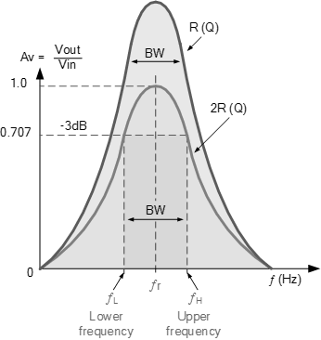
Cut-off Frequency
The resonance effect can be used for filtering the rapid change in impedance near resonance and can be used to pass or block signals close to the resonance frequency.
The bandwidth is measured between the cutoff frequencies.
Cutoff frequency is defined as the frequency at which the power passed through the circuit has fallen to half the value passed at resonance.

Slide 10
Grounding
Grounding can be defined as the control of accidental currents to protect power system from damage and malfunctioning.
Grounding is the control of abnormal voltages through proper application of Ohm’s Law: V = IR + jIX_{C} + jIX_{L}
In grounding the circuit, the circuit of an electrical system is connected to a common point of reference, typically, the earth.

Slide 11
Purpose of Grounding
Grounding is necessary for an equipment that has no insulation and is susceptible to a human contact.
Grounding protects human life, buildings, machinery and electrical appliances under fault conditions.
Grounding serves as return conductor in electric traction system and communication.
Grounding is also done to stabilise the voltage level throughout an electrical system.
Grounding provides a reference voltage level against which all other voltages in an electrical system are established and measured.

Slide 12
Types of Grounding, Advantages and Disadvantages
Underground System: It is a system which is connected to ground through the capacitance between the lines and the earth.
Resistance Grounding: In this, the neural line and the ground is connected through resistor. The resistor is used to limit the fault current through neural line.
Solid Grounding: In this, the system is connected directly to the ground, without any resistance in-between.

Slide 13
Grounding vs Earthing
Earthing is the process through which electrical discharges in an electric system is directed to the earth, whereas, grounding provides a return path to the current.
Earthing prevents power system from malfunctioning whereas, grounding protects a person from getting shock.
Earthing possesses zero potential while grounding does not possess zero potential.

Slide 14
Electricity and Magnetism
A changing electric field creates a magnetic field and a changing magnetic field creates an electric field.
Electricity and magnetism together form the basis of electromagnetism.
In Electromagnetic Wave, the electric field and magnetic field are perpendicular to one another.

Slide 15
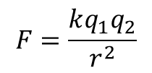
Understanding Electricity
Electricity is a stream of negatively charged particles, called electrons, flowing from negative to positive through a conductor.
The electric force is created by electric charges namely, proton and electron.
The formula to measure the electrostatic force between two points is:
$$F=\frac{kq_{1}q_{2}}{r^{2}}$$

Slide 16
Understanding Magnetism
Magnetism is the force exerted by the magnets when they attract or repel each other.
All magnets have north and south pole. Opposite poles are attracted to each other, while the same poles repel each other.
The magnetic field always loops from one pole to another.

Slide 17
Electromagnetism
Electromagnetism is the study of the electromagnetic force that is carried by electromagnetic fields composed of electric fields and magnetic fields.
Electromagnetism is one of the four fundamental interactions or forces in the nature.
The concept of electromagnetism was first given by a Danish physicist Hans Christian Oersted in the year 1820.

Slide 18
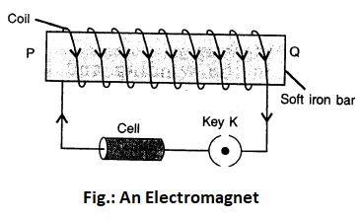
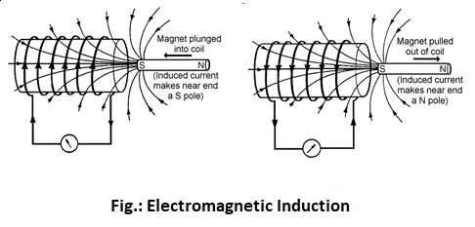
Electromagnet and Electromagnetic Induction
Electromagnet is the practical application that shows how the electric current can generate a magnetic field.
Electromagnetic Induction is the practical application that shows how a changing magnetic force can produce an electromotive force.

Slide 19




Maxwell’s Equations
Gauss’ Law for Electricity:
Gauss’ Law for Magnetism:
Faraday’s Law for Induction:
Ampere’s Circuital Law:
$$\int{E.da=\frac{1}{ε_{o}}\int{ρ.dV}}$$
$$\int{B.da=0}$$
$$\oint{E.ds}=−\frac{d}{dt}\int{B.da}$$
$$\oint{B.ds=μ_{o}\int{J.da}+μ_{o}ε_{o}\frac{d}{dt}\int{E.da}}$$

Slide 20
Applications of Electromagnetism
Electric fans, blowers and other cooling systems along with kitchen appliances like grinders use electric motor. Electric motor functions on the principle of electromagnetism.
Entertainment systems like TV, radio, stereo system, etc., consist of electromagnet.
Generators and machinery motors in industries work on the principle of electromagnetism.
The modern transportation system of maglev trains are based on the concept of electromagnetism.
Many of the medical stuffs like magnetic resonance imaging, hyperthermia treatment etc. work based on the electromagnetism.

Slide 21
Thank You

